Slide 1


📈 Credit Risk Dashboard
Power BI Project by Biswarup Das
by Biswarup Das

Slide 2
Credit Risk Dashboard
Author
Tool Used
Date
Biswarup Das
Microsoft Power BI
[Insert Date]

Slide 3

Project Objective
Identify Risk
Merge financial profiles with card behavior data.
Analyze Users
Focus on low credit scores and dark web exposure.
Combine Data
Integrate multiple sources for richer insights.

Slide 4
Dataset Overview
users_data.csv
cards_data.csv
2000 rows, 15+ columns
6146 rows, 10+ columns
Credit score, yearly income, total debt
Card brand, has chip, card on dark web
Join Key: users_data.id = cards_data.client_id

Slide 5

Data Relationship
Model View: One-to-Many relationship from users_data.id to cards_data.client_id
Cross-filter direction: Single

Slide 6
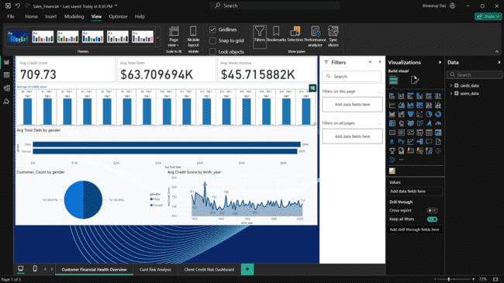
Dashboard Layout
Visuals Used
Cards: Total Clients, Avg Credit Score, High Risk Clients
Bar Chart: Dark Web Cards by Brand
Scatter Plot: Credit Score vs Total Debt
Table: Combined user & card info
Slicers: Gender, Card Brand, Has Chip

Slide 7

Key Metrics (DAX)
Total Clients = COUNTROWS(Users)High Risk Clients = CALCULATE(COUNTROWS(Users), Users[credit_score] < 600)Avg Credit Score = AVERAGE(Users[credit_score])Dark Web Cards = CALCULATE(COUNTROWS(Cards), FILTER(Cards, LOWER(TRIM(Cards[card_on_dark_web])) = "yes"))Pct Cards on Dark Web = DIVIDE([Dark Web Cards], COUNTROWS(Cards), 0)

Slide 8

Insights
Low Credit Score
Often linked to high total debt.
Dark Web Exposure
Primarily Mastercard users affected.
Age Range
Most flagged users are 30-40 years old.

Slide 9

Recommendations
Security Audits
Credit Counseling
Prioritize for high-limit card users.
Notify & Support
Offer to low-score users.
Users with dark web exposed cards.

Slide 10
Files Delivered
Power BI Dashboard (CreditRisk.pbix)
PPT Report (CreditRisk_Summary.pptx)
CSV Files (users_data.csv, cards_data.csv)
GitHub README & MIT LICENSE

Slide 11

Thank You!
Prepared by: Biswarup DasPortfolio Project
Questions? Feedback? Let's connect!

